Slide 1
GUIDE TO SETUP ES6 DEVELOPMENT ENVIRONMENT

Slide 2
Content
Babel
Webpack

Slide 3
Content (cont’d)

Slide 4
Babel
Babel is a Tran Spinnaker that just converts the code from ES6 to ES5 to support all modern browsers.
Please visit this official BabelJS website. https://babeljs.io/

Slide 5
Webpack
Webpack is a module bundle for modern JavaScript web applications.
Using a webpack, we do not host multiple JavaScript files. We just host one file for an entire web application.
Please visit this official Webpack website. https://webpack.js.org/

Slide 6

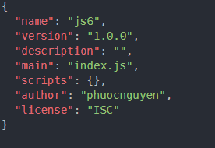
Setup ES6 Development Environment
Step 1: Create a project folder
Step 2: Create a package.json file
package.json

Slide 7
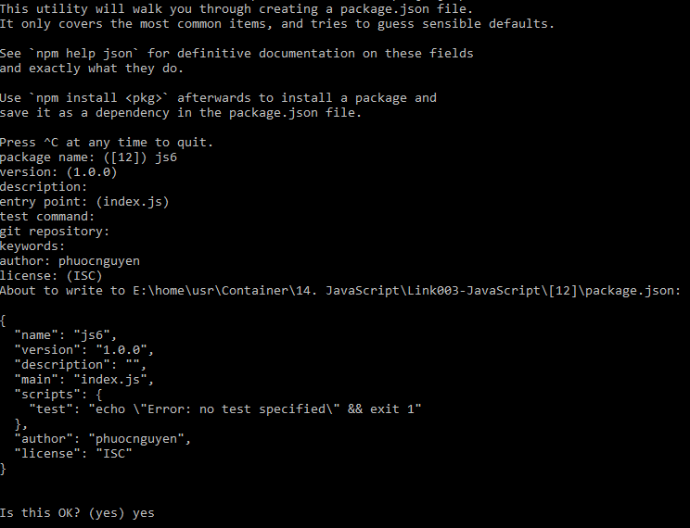
Setup ES6 Development Environment
> npm init

Slide 8

Setup ES6 Development Environment
Step 3: Install webpack globally and locally

Slide 9
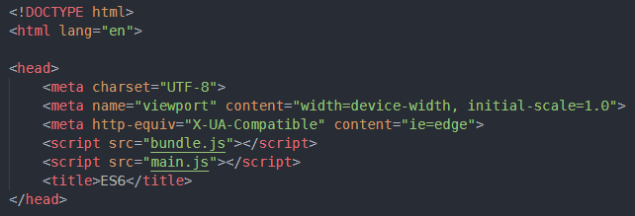


Setup ES6 Development Environment
Step 4: Include bundled file in the HTML page.
Create an index.html file in the root folder
In that create a javascript file called main.js
main.js
bundle.js
index.html

Slide 10
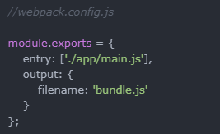
Setup ES6 Development Environment
Step 5: Create a webpack configuration file
webpack.config.js

Slide 11

Setup ES6 Development Environment
Step 6: Install the webpack development server
To get webpack locally: “npm install --save-dev webpack-dev-server”
Now analyze the terminal, It says that your project will serve on http://localhost:8080

Slide 12
Setup ES6 Development Environment
Step 7: Use Babel in our development environment
We need to configure Babel.js in our webpack environment.
“npm install babel-core babel-loader babel-preset-es2015 --save-dev”
It will update our package.json file.

Slide 13
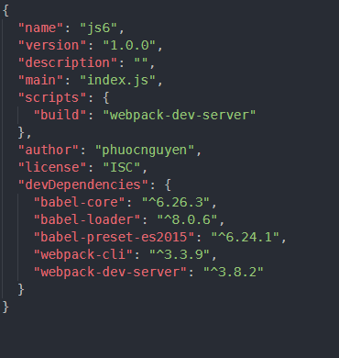
Step 7: Use Babel in our development environment (cont’d)
Update our package.json file
Babel-core and babel-loader is the dependency, which transpiles the ES6 to ES5
Babel-preset-es2015 let us use some advanced features of ECMA Script in our web applications.
package.json

Slide 14
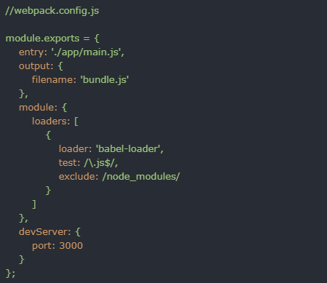
Setup ES6 Development Environment
Step 8: Edit webpack.config.js file
Here we have added module object, which has loaders property
It will accept an array of loader configuration, like which loader we want to use and which file we have to test with the extension .js and which file we need to exclude from transpiling from es6 to es5 like “node_modules” folder.
I have added one optional attribute called devServer
It includes a port number on which we need to host our app. by default webpack-dev-server provides port 8080
We can change it and put port 3000

Slide 15
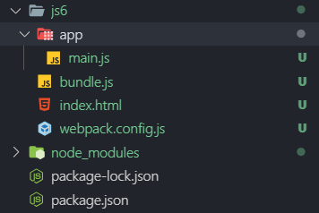
Setup ES6 Development Environment
Directory structure

Slide 16
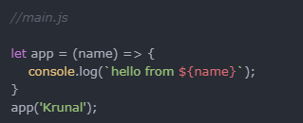
Setup ES6 Development Environment
Step 9: Write the ES6 code into our main.js file

